Slide 1


Task Scheduling
in Data Centers
H. Jonathan Chao
ECE Department
chao@nyu.edu

Slide 2
Outline
Background of flow/task scheduling
Sigcomm 2011 D³ : Better Never than Late
Sigcomm 2013 pFabric: Minimal Near-Optimal Datacenter Transport
Sigcomm 2014 Baraat: Decentralized Task-Aware Scheduling
NSDI 2015 Qjump: Queues Don’t Matter When You Can JUMP Them!

Slide 3







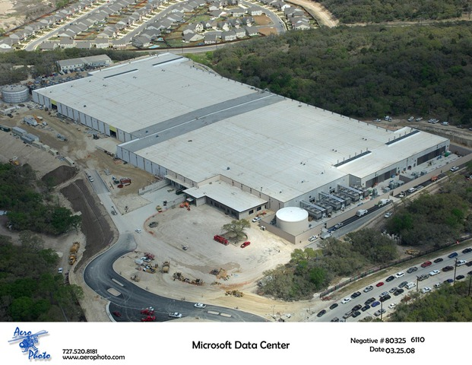










Hierarchical Task Processing
TLA
(Top-level Aggregator)
1.
Partition/Aggregate Application Structure
Picasso
Art is…
2. Art is a lie…
Deadline = 250ms
3.
…..
Time is money
Strict deadlines
Service-level
Agreements (SLAs)
Missed deadline
Low service quality result
Many requests per query
Tail-latency matters
Picasso
MLA
………
MLA
(Mid-level Aggregator)
1.
1. Art is a lie…
2.
Deadline = 50ms
2. The chief…
…..
3.
…..
3.
“Everything you can imagine is real.”
“Computers are useless.
They can only give you answers.”
“It is your work in life that is the ultimate seduction.“
“Bad artists copy.
Good artists steal.”
“I'd like to live as a poor man
with lots of money.“
“Art is a lie that makes us
realize the truth.
“The chief enemy of creativity is good sense.“
“Inspiration does exist,
but it must find you working.”
Deadline = 10ms
Worker Nodes

Slide 4
Types of Tasks in Data Centers
Partition-aggregate
Sequential
Refer to DeTail (ACM CCR 2012), DCTCP (ACM CCR 2011)

Slide 5
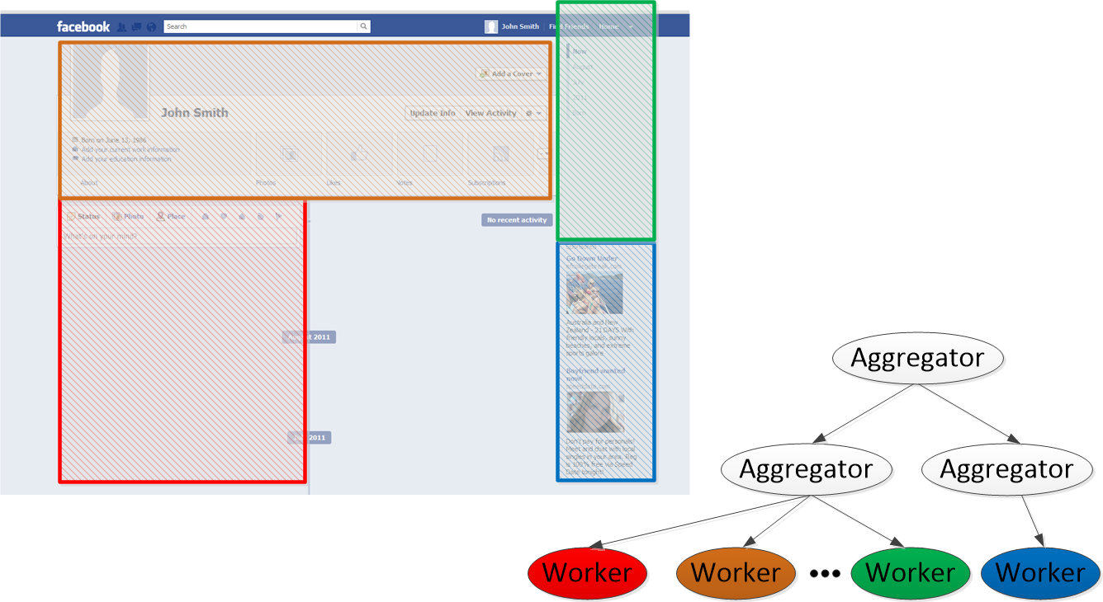
Types of Tasks in Data Centers
Example: Facebook news feed
In response to user query, each section of the page is generated as a smaller task
- Loading ads depends on the results of previous task.
- Revenue is generated when users click on ads
Targeted Ads can only be loaded when user’s data and history is ready. In other words, loading Ads depends on loading other parts of the page.
Facebook generates revenue when users click on the Ads. Therefore, revenue is generated when both the content and the ad are shown to the user.

Slide 6
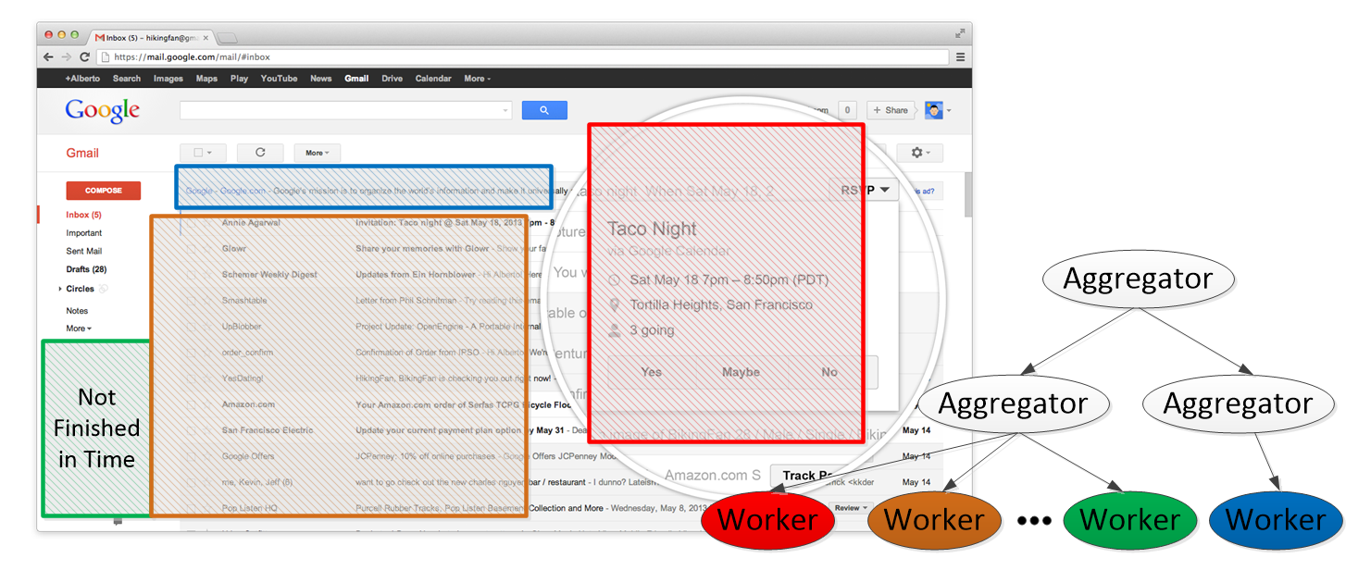
Types of Tasks in Data Centers
Example: Gmail
Ads and suggestions are loaded based on the content of emails (Dependency of tasks)
Page is not loaded properly (Workers missing deadline)
Failure in loading ads does not affect user’s experience. However, it decreases potential revenue for Google.
Page is not loaded properly. It degrades the user experience, and potentially decreases Google’s revenue.

Slide 7
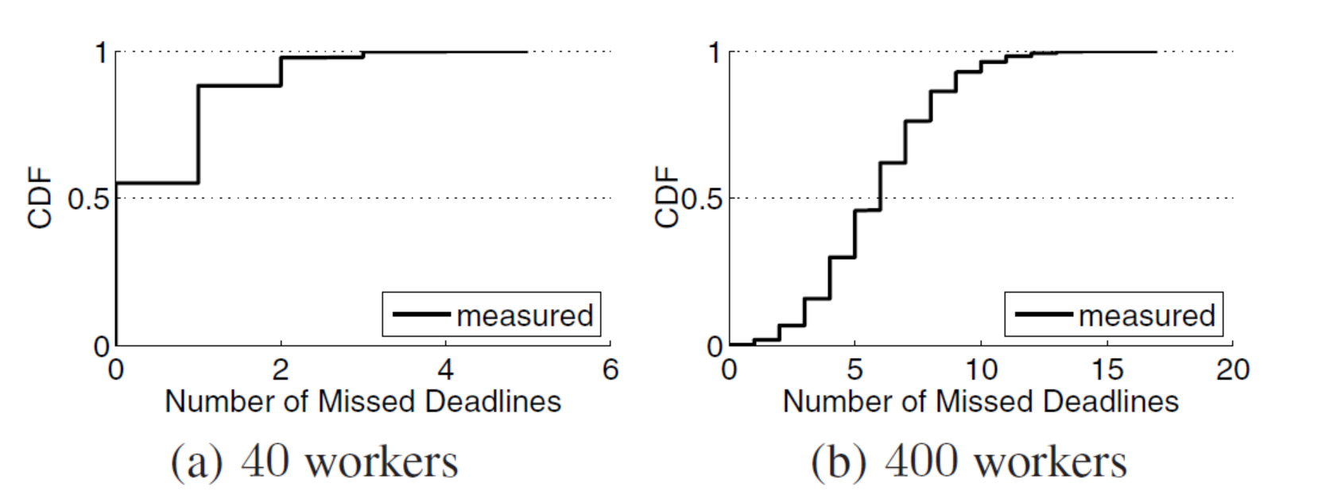
Measurement at Bing data centers
Adapted from DeTail (ACM CCR 2012)
In practice deadlines are missed quite often, when
Performing a web search (e.g., 40 workers)
Doing lengthy background tasks (e.g., 400 workers)
~15% missed at least 2 deadlines
~55% missed at least 6 deadlines

Slide 8
Scheduling in Data Centers
A topic of attention during the recent years, both in industry and academia
D3: “Better Never than Late: Meeting Deadlines in Datacenter Networks” [Sigcomm’11]
pFabric: “Minimal Near-Optimal Datacenter Transport” [Sigcomm’13]
Baraat: “Decentralized Task-Aware Scheduling for Data Center Networks” [Sigcomm’14]
QJump: “Queues Don’t Matter When You Can JUMP Them!” [NSDI’15]

Slide 9
D3: Deadline-Driven Delivery control protocol

Slide 10
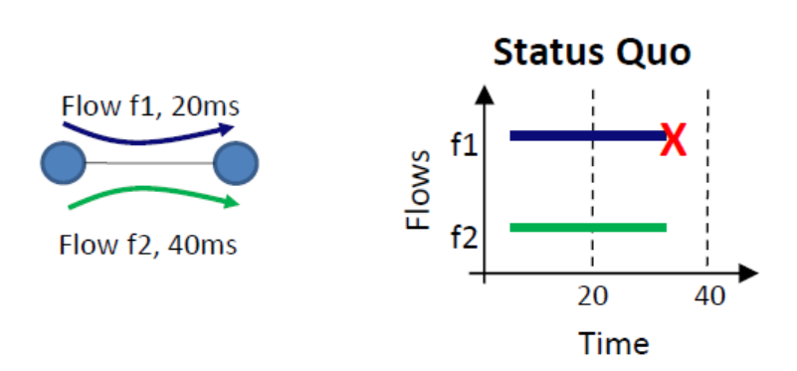
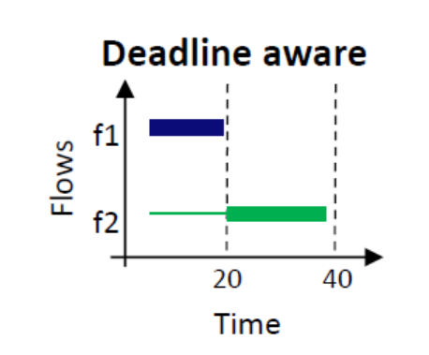
D3: Limitations of fair sharing
Flows in the data center typically fair share the links.
Missed the deadline
Deadline: 20 or 40 ms
F1 and F2 fair share the network:
F1 misses its deadline.
F1 and F2 gets bandwidth according to their deadlines:
Both meet their deadlines.

Slide 11
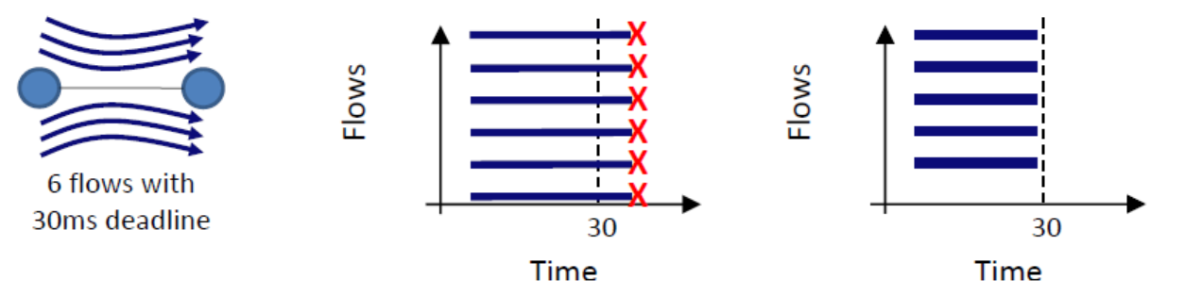
D3: Limitations of fair sharing
What if we don’t have enough resources?
Fair share:
All of the flows miss their deadlines.
Terminating one of the flows:
5 flows meet their deadline.

Slide 12


D3 Overview
No priority queuing at routers. They do not do any packet or flow scheduling, but just allocate the rates for end hosts at each round (RTT) of polling.
RRQ(r)|α₁
RRQ(r)|α₁|α₂
s: Flow size
d: Flow Deadline
α: Allocated BW
RRQ: Rate Request
RRQ(r)|α₁|α₂|Ack
RRQ(r)
Rate control is performed at end host which enforces minimum of allocated rates.
Sender exposes (s, d) → r = s/d
Routers allocate rates (α) based on traffic load
Determine s𝑒𝑛𝑑𝑖𝑛𝑔 𝑟𝑎𝑡𝑒 𝑓𝑜𝑟 𝑛𝑒𝑥𝑡 𝑅𝑇𝑇∶ sr= min (α₁, α₂)
Send data at rate 𝑠𝑟
The source sends data at this rate for a RTT while one of the data packets sent in this RTT will carry a rate request for the next RTT.
The source periodically (every RTT) asks the network for a new allocation.

Slide 13
D3: Rate Allocation
Allocated rate (α):
When available capacity > ∑(desired rates):
For deadline flows : α = r + fs
For non-deadline flow (r=0): α = fs
When available capacity is not enough to satisfy all requests:
Greedily satisfy requests: D3 satisfies as many flows as possible according to the flow request rates in the order of their arrivals.
fs : fair-share after satisfying flow requests
r : desired rate

Slide 14
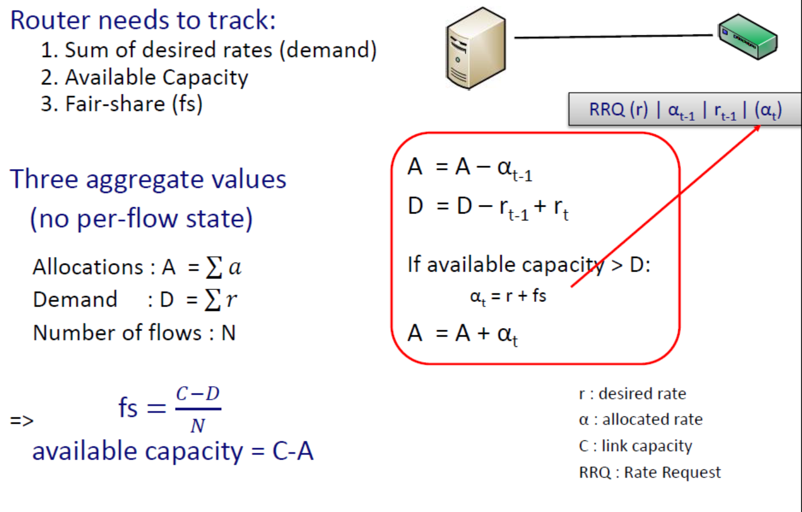
D3: Rate Allocation

Slide 15
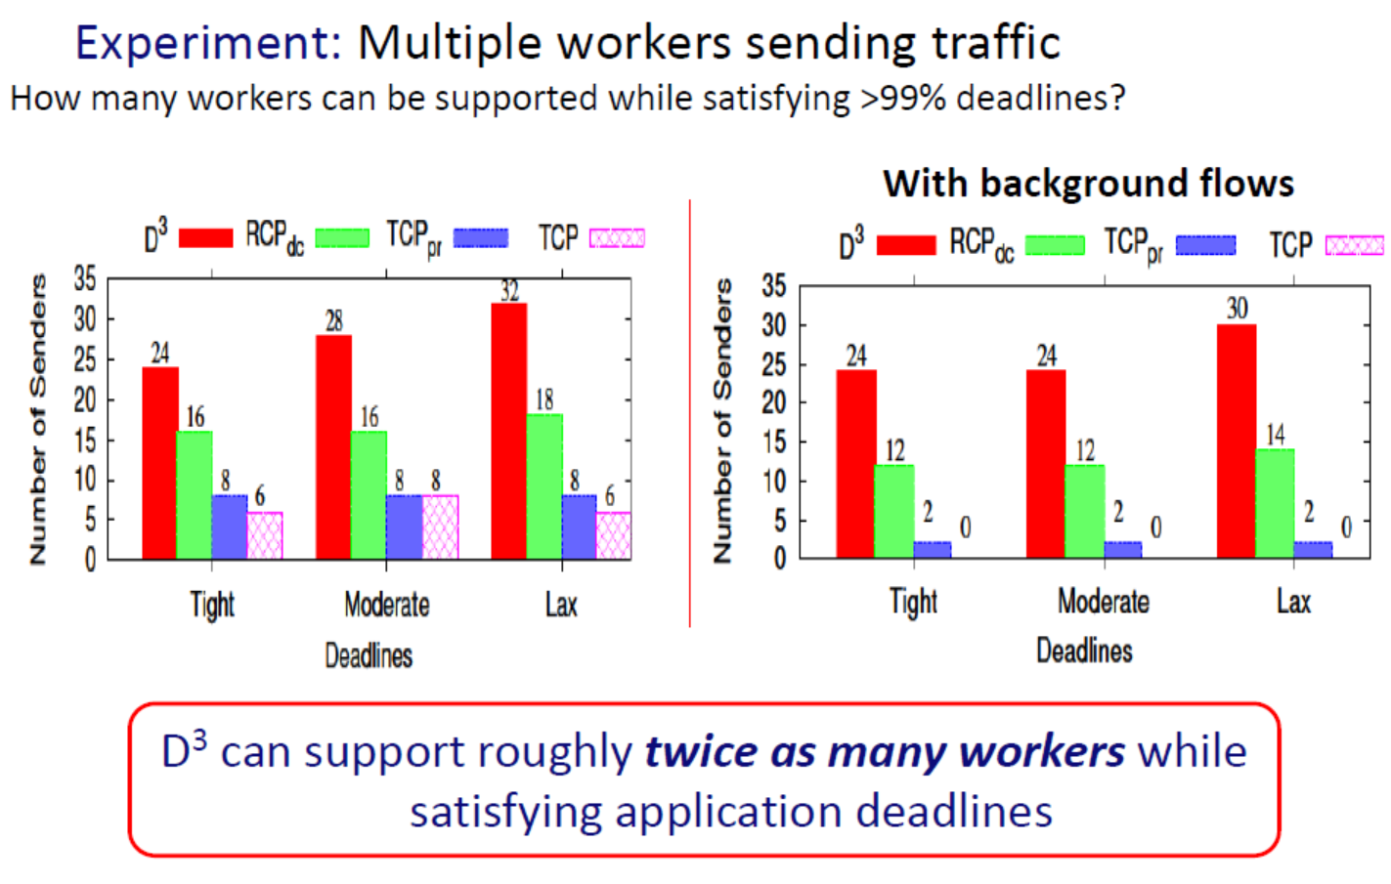
D3 in action

Slide 16
D3: Summary
Main idea: Make the network aware of flow deadlines
Prioritize flows based on deadlines from their requested rates (No fair sharing)
A deadline-aware datacenter transport protocol that:
schedules network traffic based on SLAs (Service Level Agreements)
can double the peak load a datacenter supports
performs well as a congestion control protocol
Advantages:
Improve quality of responses
Save resources

Slide 17
D3: Summary - Disadvantages
D3 is a new transport protocol
To implement it we need to modify both end hosts as well as switches
Not backward compatible
Not suitable for incremental deployment
Not robust with legacy transport protocols
Having TCP/UDP flows at the same time degrades D3 performance
What are other disadvantages?
Allocate bandwidth to some flows but only find that they are bottlenecked at the downstream
Big flows may take away bandwidth from small flows that arrive late
No deadline guarantee
Wait for at least one RTT before sending data

Slide 18
pFabric: Minimal Near-Optimal Datacenter Transport

Slide 19

Transport in Datacenters
DC network interconnect for distributed compute workloads
Msg latency is King traditional “fairness” metrics less relevant
1000s of server ports
web
app
cache
db
map-reduce
HPC
monitoring
Notes:
To set the context, I’m going to start with the observation that the modern datacenter network is more an interconnect for distributed compute workloads than a traditional bit-pipe.
We basically have these large fabrics which provide very high bandwidth very low latency connectivity among thousands of servers;
and on top of this infrastructure, we run multi-tiered clustered applications supporting web services, big data analytics, HPC, etc.
These applications have many distributed components – and there are often 100s of servers involved in a computation to respond to a user query. Hence, the performance….

Slide 20
pFabric in 1 Slide
Packets carry a single priority #
e.g., prio = remaining flow size
pFabric Switches
Very small buffers (20-30KB for 10Gbps fabric)
Send highest priority / drop lowest priority pkts
pFabric Hosts
Send/retransmit aggressively
Minimal rate control: just prevent congestion collapse
Notes:
Remember to say: “Set independently by each flow”

Slide 21
Conceptual model

Slide 22
DC Fabric: Just a Giant Switch
H1
H2
H3
H4
H5
H6
H7
H8
H9

Slide 23
DC Fabric: Just a Giant Switch
H1
H1
H1
H2
H2
H2
H3
H3
H3
H4
H4
H4
H5
H5
H5
H6
H6
H6
H7
H7
H7
H8
H8
H8
H9
TX
H9
H9
RX

Slide 24
DC Fabric: Just a Giant Switch
H1
H1
H2
H2
H3
H3
H4
H4
H5
H5
H6
H6
H7
H7
H8
H8
TX
H9
H9
RX

Slide 25
DC transport = Flow scheduling on giant switch
Objective: Minimize avg FCT
(flow completion time)
H1
H1
H2
H2
H3
H3
H4
H4
H5
H5
H6
H6
H7
H7
H8
H8
TX
H9
H9
RX
ingress & egress
capacity constraints

Slide 26
“Ideal” Flow Scheduling
Problem is NP-hard ☹ [Bar-Noy et al.]
Simple greedy algorithm (shortest flow first)
1
1
2
2
3
3
Notes:
State explicitly that you can’t actually build this in practice the way it is described
Central, etc

Slide 27
pfabric design

Slide 28

Key Insight
Decouple flow scheduling from rate control
Switches implement flow
scheduling via local mechanisms
Hosts implement simple rate control to avoid high packet loss
H1
H2
H3
H4
H5
H6
H7
H8
H9
Notes:
“you should not use rate control to implement flow scheduling… decouple”

Slide 29
pFabric Switch
H1
H2
H3
H4
H5
H6
H7
H8
H9
Priority Scheduling send highest priority packet first
Priority Dropping drop lowest priority packets first
5
9
3
4
Switch Port
2
3
6
7
1
small “bag” of packets per-port
prio = remaining flow size

Slide 30
pFabric Switch Complexity
Required buffers are very small: ~2×BDP (bandwidth delay product) per-port
e.g., C=10Gbps, RTT=15µs → Buffer ~ 30KB
Today’s switch buffers are 10-30x larger
Priority Scheduling/Dropping
Worst-case: Minimum size packets (64B)
No. of packets in the buffer = 30KB/64B = ~600
51.2ns to find min/max of ~600 numbers
Binary comparator tree: 10 clock cycles
Current ASICs: clock ~ 1ns, can be done in ~10ns
Notes:
Use small buffers as an advantage (not as a requirement)

Slide 31

pFabric Rate Control
With priority scheduling/dropping, queue buildup doesn’t matter
Greatly simplifies rate control
Only task for RC:
Prevent congestion collapse when elephants collide by using a minimal version of TCP
50% Loss
H1
H2
H3
H4
H5
H6
H7
H8
H9

Slide 32
pFabric Rate Control
H1
H2
H3
H4
H5
H6
H7
H8
H9
Minimal version of TCP algorithm
Start at line-rate
Initial window larger than BDP
No retransmission timeout estimation
Fixed RTO at small multiple of round-trip time
Reduce window size upon packet drops
Window increase same as TCP (slow start, congestion avoidance, …)

Slide 33
Why does this work?
Key invariant for ideal scheduling:
At any instant, have the highest priority packet (according to ideal algorithm) available at the switch
Priority scheduling
High priority packets traverse fabric as quickly as possible
What about dropped packets?
Lowest priority packets will be dropped when we run out of space
Buffer > BDP → enough time (> RTT) to retransmit
Notes:
If we step back, what are we trying to do? And tie to the conceptual ideal scheduelr
When might this invariant break?
This might happen if at an earlier point in time we dropped this packet because earlier high priority packets caused it to be dropped
Can this happen in pfabric’s design?
It cannot because…

Slide 34
Overall Average FCT
Recall: “Ideal” is REALLY idealized!
Centralized with full view of flows
No rate-control dynamics
No buffering
No pkt drops
No load-balancing inefficiency
Notes:
Normalized to the case where there is no other competing traffic

Slide 35
Mice FCT (<100KB)
Average
99th Percentile
Almost no jitter
Notes:
Play up the tail latency

Slide 36
Conclusion
pFabric: simple, yet near-optimal
Decouples flow scheduling from rate control
What are the disadvantages?
A clean-slate approach, requiring new switches and minor host changes
Sorting packets’ priorities is complex
No deadline guarantee
Large flows may be starved

Slide 37
Baraat: Decentralized Task-Aware Scheduling for Data Center Networks

Slide 38
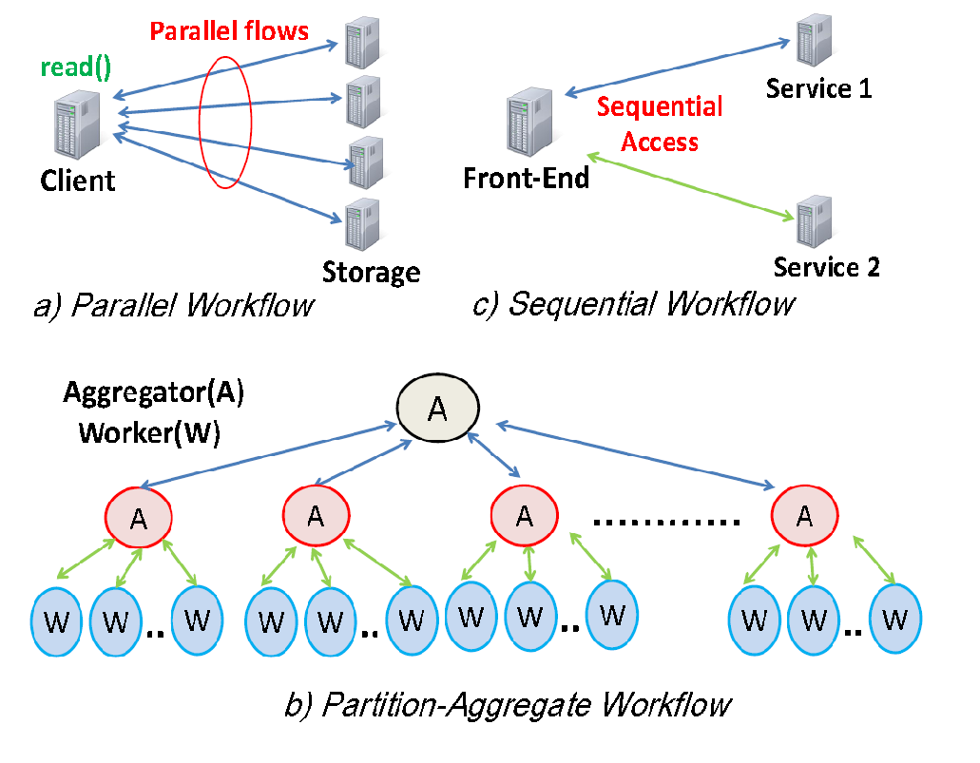
Common Workflows
Task: the unit of work for an application that can be linked to a waiting user
A single task may have multiple active flows in the network
A task is only completed when all of its flows are done

Slide 39
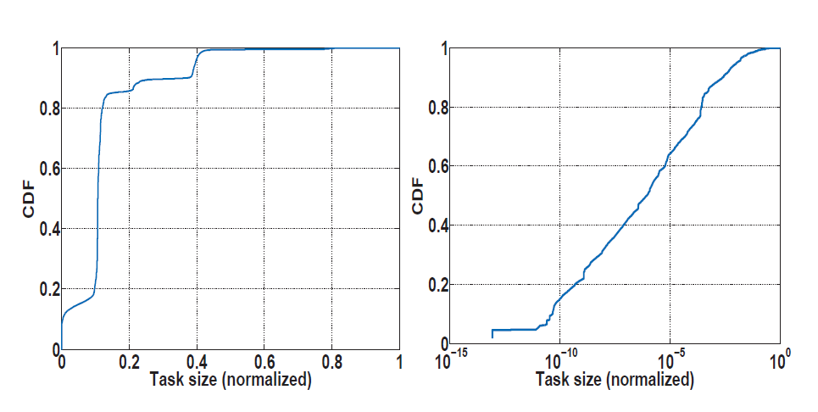
Task-Characterization: Size
Two features of application tasks in today’s data centers: 1) the task size and 2) the number of flows per task.
A task’s size is the sum of the sizes of network flows involved in the task.
Distribution of task sizes for Search tasks (on the left) and Data analytics tasks (on the right)
Heavy-tailed nature for some tasks
5% of web search tasks are very large in terms of size
35% of MapReduce tasks are very large in terms of size

Slide 40
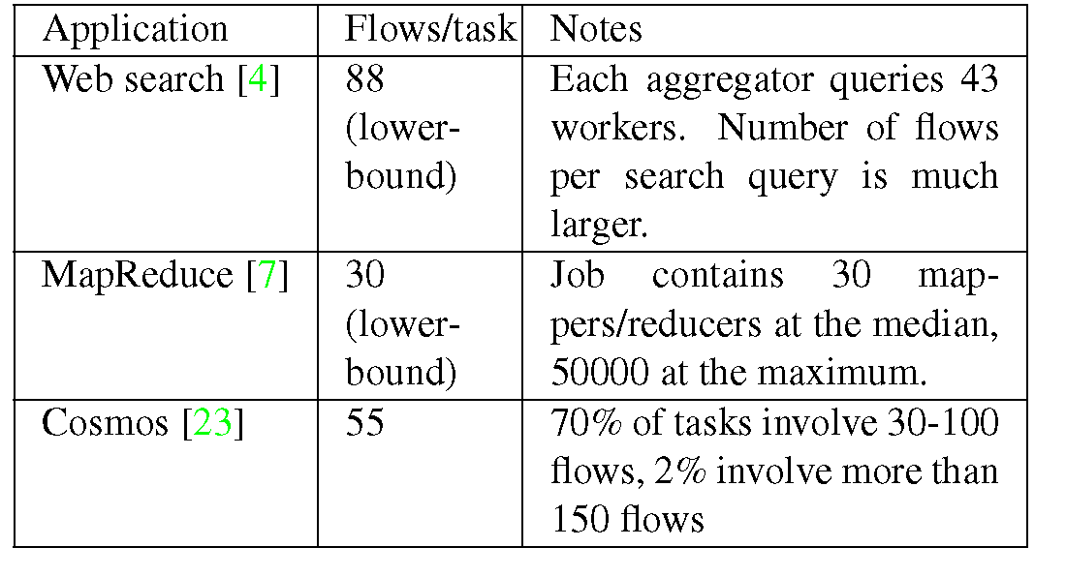
Task-Characterization: #Flows
From 10s, to 100s or 1000s

Slide 41
Flow-based Scheduling Policies
Flow-based policies
Fair-sharing (equal amount of bandwidth to all the flows)
Completion time of flows ↑
Task completion time ↑
Latency ↑

Slide 42
Flow-based scheduling is not efficient
Priority Scheduling send highest priority flow first
5
Task-Aware Scheduling
9
3
4
Switch Port
2
3
6
Allows applications to expose their semantics to the network, and the network to optimize for application-level metrics
7
1
A task is not completed, unless all of its flows are finished
A single task may include several flows. Assume flows 1 & 7 belong to the same task.

Slide 43
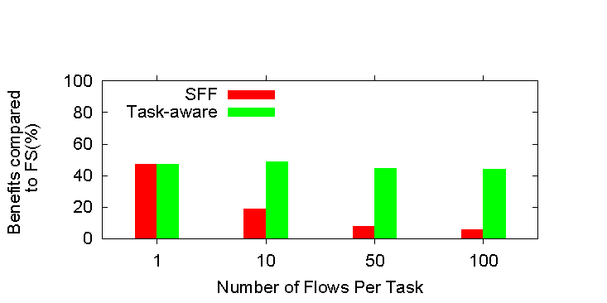
Task-aware scheduling
Reduction in task completion time, Task-aware scheduling and Shortest Flow First (SFF) scheduling (similar to pFabric) compared to Fair Share (FS) scheduling.
Task-aware scheduling is more efficient when tasks have more flows.

Slide 44
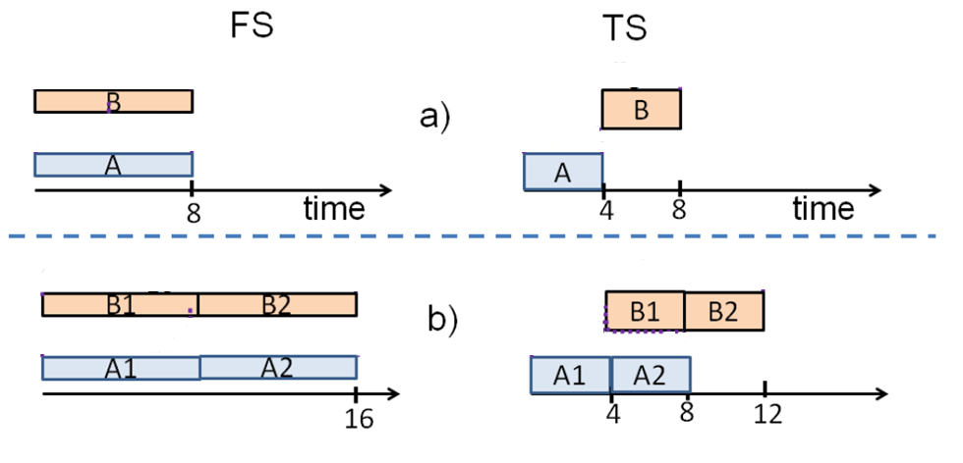
Scheduling Policies: Task Serialization (TS) vs. Fair-Sharing (FS)
Each task has 4 units of data
Tasks A and B share the same link, Task serialization improves the average completion time.
Tasks A and B, each has two stages to finish the task and each stage has 4 units of data.
Each stage has a different network bottleneck, which is the case for an application like search, where down- link to the mid-level aggregator is the bottleneck in the first stage and downlink to the top-level aggregator is the bottle neck in the second stage.
So, skewing them will reduce the contention and reduces both of their completion times.

Slide 45
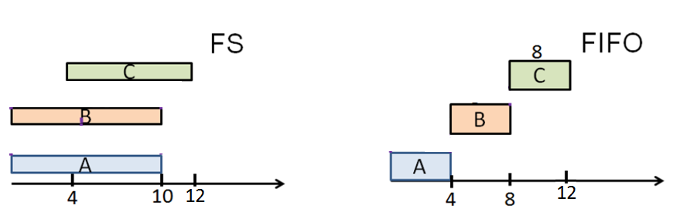
Task Serialization Policies
Each segment has
4 units of data
Advantages of TS:
Task’s waiting time depends ONLY on the tasks that arrive before it
Can reduce both the average and tail task completion times compared to FS.
Disadvantages of TS:
Heavy tasks block the execution of short tasks.

Slide 46
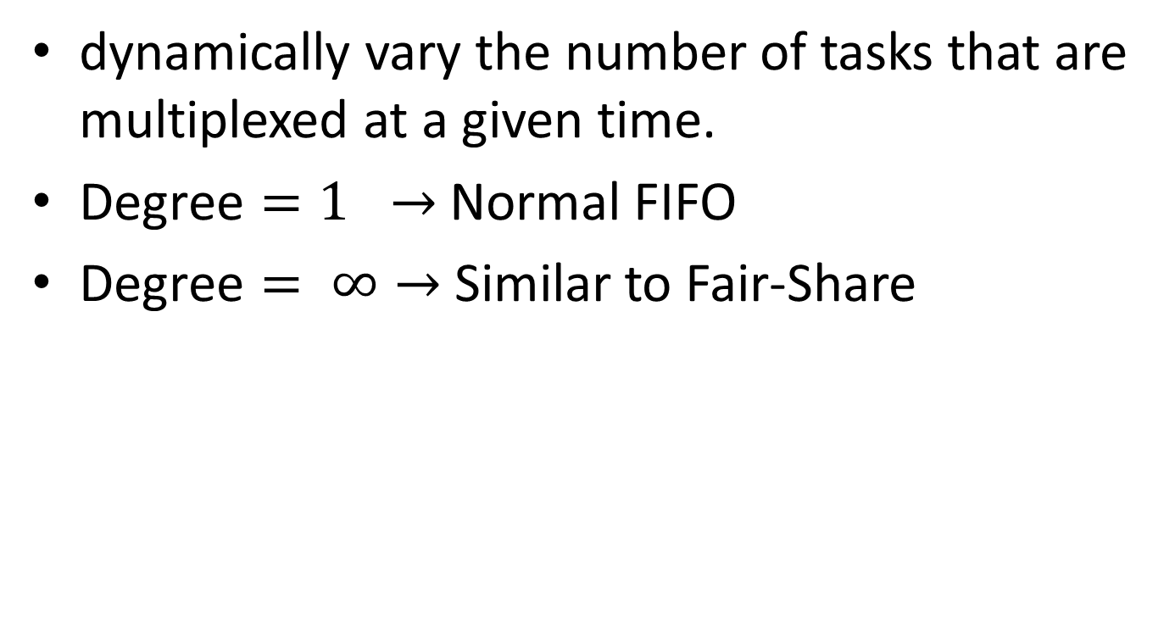
FIFO with Limited Multiplexing
S
Degree

Slide 47
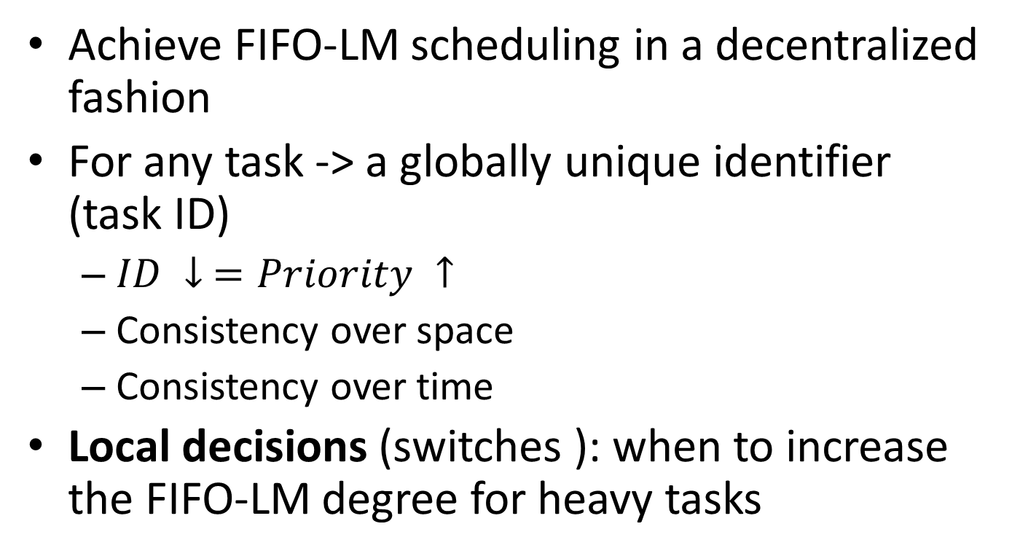
Baraat
Smaller ID means arriving
at the switch earlier

Slide 48
Baraat: Generating Task Identifiers
Monotonically increasing counter(s) to keep track of incoming tasks (i.e., task’s task-id)
Based on task’s arrival (or start) time.
Some common points used to generate ids:
The load balancer (for user-facing applications like web search)
The job scheduler (for data parallel and HPC applications)
The metadata manager (for storage applications), …
Propagation of task identifiers by applications

Slide 49
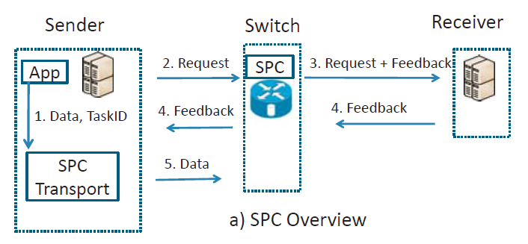
Smart priority classes (SPC) Overview
Similar mechanism to D3 flow rate control, the difference is that D3 assumes that the flow size is available and calculates average desired rate, while Baraat uses current buffer size to create fine-grained demand. Priority classes are used to support task preemption and detecting heavy flows.
SPC Transport calculates the demand
SPC request is passed to the switch
Switch adds feedback and forwards the packet
Receiver piggybacks consolidated feedback and acknowledgment
Sender uses feedback to adjust the rate for this RTT
This process is repeated for every RTT

Slide 50
Baraat: Overview
Smart Priority Class: A proposed prioritization mechanism
SPC employs an explicit rate based protocol:
Switches assign rates to each flow (of a task)
End-hosts send at the assigned rate
Each switch has a classifier that maps flows to classes and is responsible for handling heavy tasks (heavy-tailed support)
Flows mapped to a higher priority class get preference over those mapped to a lower priority class.
Flows mapped to the same priority class fair share the resources.

Slide 51
Smart Priority Class
One-to-one mapping between task IDs and priority classes (highest priority task is mapped to the highest priority class and so on.)
FIFO scheduling: tasks are scheduled by their priority (i.e. the task ID, monotonically increasing)
To implement FIFO-LM classifier identifies heavy tasks on the fly.
Each switch counts the total number of bytes served for each task, upon exceeding a pre-determined threshold, the task is identified as heavy.
Subsequently the heavy task and the task immediately next in priority share the same priority class. Flows of the two tasks are served in round-robin.
If Task2 is finished, Task3 is prompted and served together with Task1.
Switch
Mappings
SPC1 | Task1 Task2
SPC3 | Task3
Mappings
SPC1 | Task1
SPC2 | Task2
SPC3 | Task3
Heavy- tailed
SPC1
SPC2
SPC3

Slide 52
Smart Priority Class: at the switch
Each switch keeps 3 counters for each task k:
A total allocated rate across all flows (A)
The sum of flow demands belonging to class k (D_{k})
The number of flows belonging to class k (F_{k})
Also, a single aggregate counter for each link keeps track of the bandwidth allocations that have already been made.

Slide 53
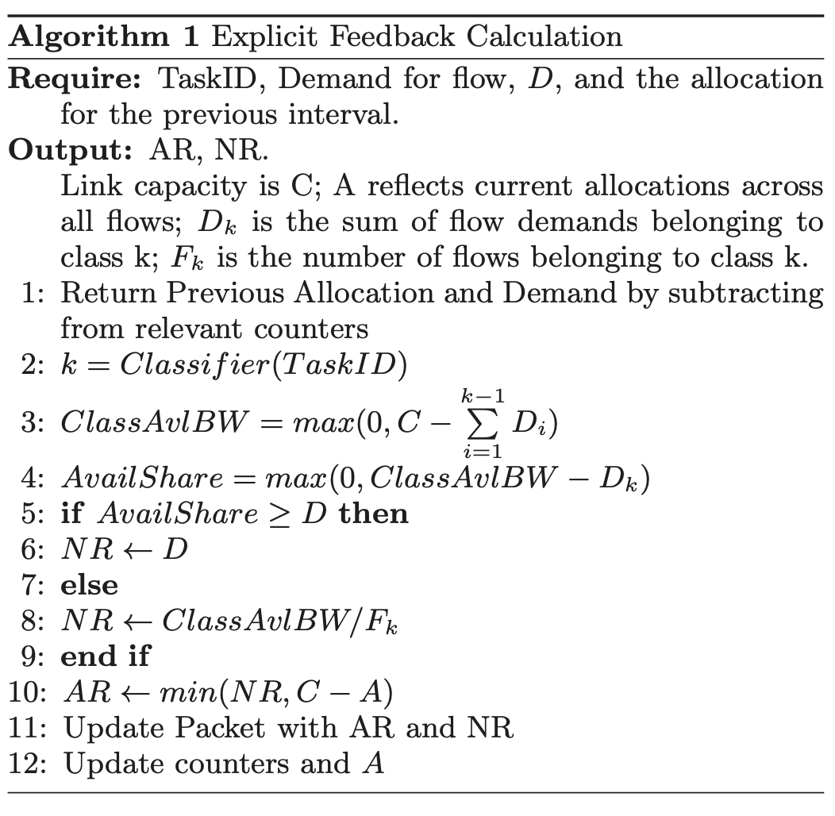
An actual rate (AR) is the rate a sender should send data in the next RTT.
A nominal rate (NR) is the maximum share of the flow based on its priority.
NR might be greater than AR because the switch might have already assigned bandwidth to a lower priority flow which needs to be preempted before NR is available.
NR essentially allows senders to identify their current nominal bottleneck share, which they use to adjust their demand, thus allowing other switches along the path to free up unused bandwidth and allocate it to lower- priority flows (i.e., work conservation).

Slide 54
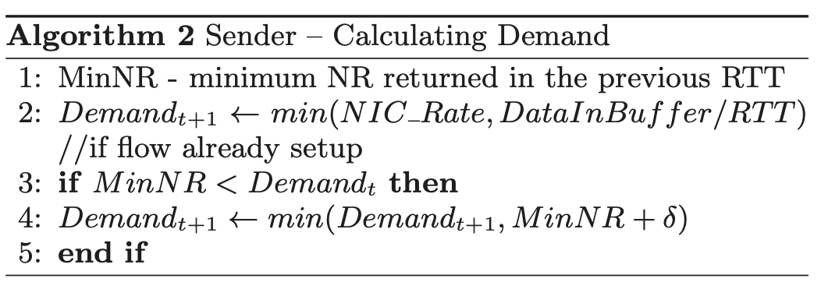
Demand calculation is more accurate and reflects not only how much data the sender can send, but also how much data the bottleneck link on the path can support.
A more accurate demand ensures that non-bottleneck switches only reserve what is required by the flow, which leads to work conservation in multi-hop settings.
Based on the earlier feedback from switches (the NR and AR vectors), the sender identifies the bottleneck rates: it transmits data at the minimum of the rates specified in the AR vector and uses the NR vector to determine how much it should demand in the next RTT.
If the flow is bottlenecked on a network link (i.e., the minimum of the NR vector is less than the previously requested demand), the sender lowers its demand for the next RTT and sets it equal to NR + δ.
Lowering the demand allows other links to only allocate the necessary bandwidth that will actually be used by the flow, using the rest for lower priority flows (i.e., work conservation).
Adding a small value (δ) ensures that whenever the bottleneck link frees up, the sender recognizes this and is able to again increase its demand to the maximum level.

Slide 55
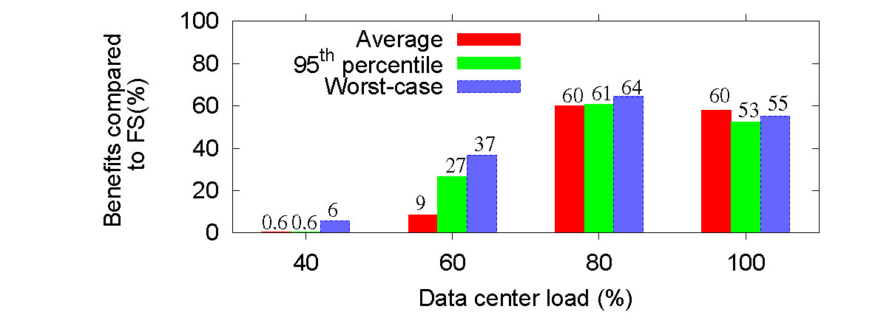
Evaluation
Reduction in task completion time for partition-aggregate workflow compared to fair sharing.
For uniform workloads, compared to pFabric, Baraat provides reduction of 66% and 75% at the 95th and 99th percentiles.

Slide 56
Baraat Features
Schedules tasks rather than flows
Uses FIFO-LM (limited multiplexing) as the scheduling algorithm
Does not need to know flow sizes
Implements a new transport protocol
Modifies switches as well as hosts
Does not meet the deadlines
Inherit the disadvantages of D3

